Slide 1
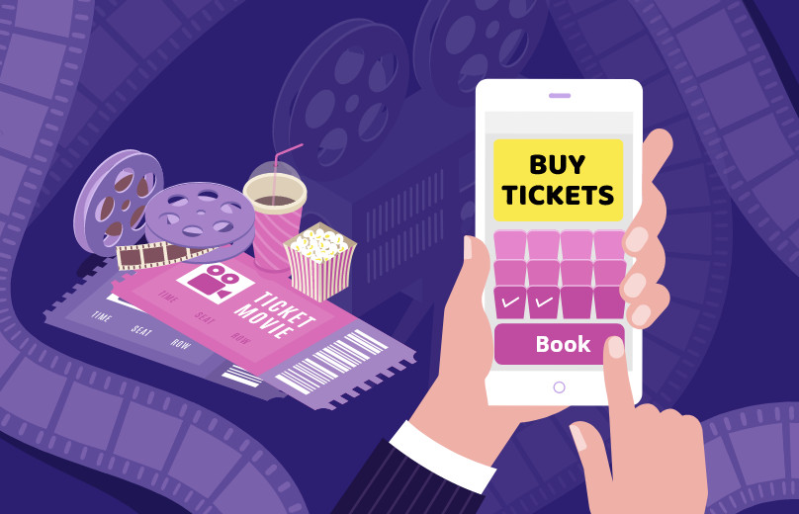
PROJECT 1(GROUP E)
MOVIE MANAGEMENT SYSTEM

Slide 2

Objective and aim of our project
OBJECTIVE:
The objective of our project is to display the ease of selecting, displaying and booking a movie ticket according to your locality, movie timing and price allowing you to book the number of seats you need.
AIM:
The project satisfies all the customer needs according to the objective allowing user to book the tickets according to their type of genre(type of movie they want to watch), number of tickets needed and also selecting the time slot you want to watch the movie in.

Slide 3
What is movie management?
A Movie Management System, also known as a Film Management System or Movie Database System, is a software application designed to organize, catalog, and manage information related to movies. This type of system is commonly used by film studios, production houses, film distributors, and even individual movie enthusiasts to keep track of various aspects of the film industry.
Key features of a Movie Management System include:
Database Management: Storing and managing information about movies, including details such as title, director, cast, release date, genre, ratings, and more.
User Management: Allowing users to create accounts, log in, and personalize their experience. This feature is particularly useful in systems catering to individual users who want to maintain their watchlists or ratings.
Search and Filters: Enabling users to search for movies based on different criteria (e.g., genre, release year, actor) and providing filters to refine search results.

Slide 4

How is movie management used ?
A Movie Management System is used in various ways depending on the target audience and purpose. Here's a breakdown of how different users might utilize such a system:
Individual Movie Enthusiasts:
Cataloging and Organizing: Users can use the system to create a personal database of the movies they have watched or plan to watch.
Watchlists: Individuals can maintain watchlists, marking movies they want to see in the future.
Ratings and Reviews: Users can rate movies they have watched and leave reviews to share their opinions with others.
Recommendations: Based on their viewing history and preferences, the system may provide personalized movie recommendations.

Slide 5
Film Industry Professionals (Studios, Production Houses, Distributors):
Production Management: Studios and production houses can use the system to manage the production process, track crew details, and monitor project timelines.
Distribution: Distributors can use the system to keep track of movie distribution, sales, and revenue.
Promotion: Professionals can utilize the system to store promotional material, manage marketing campaigns, and track the success of promotional efforts.

Slide 6
Difference between Movie Management System through Online and Direct
The difference between an online movie management system and a direct (offline or standalone) movie management system lies in how the software is accessed, utilized, and where the data is stored. Here are the key distinctions:
Online Movie Management System:
Accessibility:
Online: Accessible through a web browser, allowing users to manage and access their movie information from any device with internet connectivity.
Connectivity Requirement: Requires an internet connection for real-time access and updates.
Data Storage:
Cloud-Based: Movie data is stored on remote servers (cloud), providing scalability, flexibility, and easy access from multiple locations.
Collaboration: Allows collaboration and sharing of movie lists or databases among users.

Slide 7
Direct (Offline or Standalone) Movie Management System:
Accessibility:
Local Installation: Requires installation on a specific device (e.g., computer) and is accessible only from that device.
No Internet Dependency: Does not require a constant internet connection for regular use.
Data Storage:
Local Storage: Movie data is stored locally on the user's device, which may limit accessibility and sharing capabilities.
Backup Responsibility: Users are responsible for backing up their data to prevent loss.

Slide 8
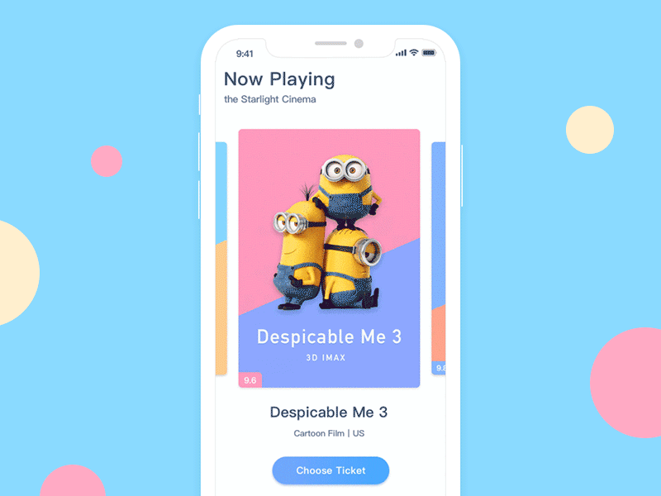
HOW A TICKET IS BOOKED FOR A MOVIE
Here is a video to display how a movie ticket is booked online:

Slide 9
Code to Add movie and select movie according to it’s genre:
class Movie: def __init__(self, title, genre, year): self.title = title self.genre = genre self.year = year class MovieManager: def __init__(self): self.movies = [] self.booking_details = {} # Store booking details def add_movie(self, title, genre, year): movie = Movie(title, genre, year) self.movies.append(movie) print(f"{title} added to the movie list.") def view_movies(self): if not self.movies: print("No movies available.") else: print("Movie List:") for movie in self.movies: print(f"{movie.title} - {movie.genre} - {movie.year}")
def filter_by_genre(self, genre): filtered_movies = [movie for movie in self.movies if movie.genre.lower() == genre.lower()] if not filtered_movies: print(f"No movies found for the genre: {genre}.") else: print(f"Movies in the {genre} genre:") for movie in filtered_movies: print(f"{movie.title} - {movie.year}") def cancel_booking(self, movie_title, screen, timing, num_tickets): key = (movie_title, screen, timing, num_tickets) if key in self.booking_details: del self.booking_details[key] print("Booking canceled successfully.") else: print("No booking found for the specified details.")

Slide 10
# Example movie_manager = MovieManager() movie_manager.add_movie("Inception", "Sci-Fi", 2010) movie_manager.add_movie("The Dark Knight", "Action", 2008) movie_manager.add_movie("Titanic", "Romance", 1997) movie_manager.add_movie("Upadyaksha", "Romance", 2024) movie_manager.add_movie("Hanuman", "Action", 2024) movie_manager.add_movie("Salaar", "Action", 2023) movie_manager.add_movie("Bachelor Party", "Comedy", 2024) movie_manager.add_movie("Ghost", "Action", 2023) movie_manager.add_movie("Thathsama Tadhbava", "Suspens", 2023) movie_manager.add_movie("Nanni", "Horror", 2023) movie_manager.add_movie("Jessy", "Horror", 2023) movie_manager.view_movies() print("*****") genre_to_filter = input("Enter the genre to filter movies: ") movie_manager.filter_by_genre(genre_to_filter)

Slide 11
Code to show how movie tickets are booked online:
global f
f = 0 #this t_movie function is used to select movie name def t_movie(): global f f = f+1 print("which movie do you want to watch?") print("1,Updayksha ") print("2,Fighter") print("3,Gunntu Karam") print("4,back") movie = int(input("choose your movie: ")) if movie == 4: # in this it goes to center function and from center it goes to movie function and it comes back here and then go to theater center() theater() return 0 if f == 1: theater()

Slide 12
# this theater function used to select screen def theater(): print("Which screen do you want to watch movie: ") print("1,Flat Screen") print("2,Horizontal Curve") print("3,Torex Sreen") print("4,3D") Screen= int(input("choose your screen: ")) ticket = int(input("number of ticket do you want?: ")) timing(Screen)

Slide 13
#Add timing and price for the movie tickets
def timing(Screen, num_tickets): ticket_prices = { "1": 10.00, # Example ticket prices "2": 12.50, "3": 15.00, "4": 18.00 } time1 = { "1": "10.00-1.00", "2": "1.10-4.10", "3": "4.20-7.20", "4": "7.30-10.30" } time2 = { "1": "10.15-1.15", "2": "1.25-4.25", "3": "4.35-7.35", "4": "7.45-10.45" } time3 = { "1": "10.30-1.30", "2": "1.40-4.40", "3": "4.50-7.50", "4": "8.00-10.45" } if Screen == 1: print("Choose your time:") print(time1) t = input("Select your time:") x = time1[t] price = ticket_prices[t] total_price = price * num_tickets print(f"Successful! Enjoy movie at {x}. Total Price: ${total_price}") key = ("Hanuman", Screen, x, num_tickets) # Example booking details movie_manager.booking_details[key] = True elif Screen == 2: print("Choose your time:") print(time2) t = input("Select your time:") x = time2[t] price = ticket_prices[t] total_price = price * num_tickets print(f"Successful! Enjoy movie at {x}. Total Price: ${total_price}") elif Screen == 3: print("Choose your time:") print(time3) t = input("Select your time:") x = time3[t] price = ticket_prices[t] total_price = price * num_tickets print(f"Successful! Enjoy movie at {x}. Total Price: ${total_price}") else: print("Tickets not available") return 0

Slide 14
#Selecting the movie theater
def movie(theater): if theater == 1: t_movie() elif theater == 2: t_movie() elif theater == 3: t_movie() elif theater == 4: locality() else: print("wrong choice")
#Type of theater you want to watch the movie
def center(): print("which theater do you wish to see movie? ") print("1,Inox") print("2,Icon") print("3,PVR") print("4,back") Screen= int(input("choose your option: ")) movie(Screen) return 0
# this function is used to select locality def locality(): print("Hi welcome to movie ticket booking: ") print("where you want to watch movie?:") print("1,Rajajinagar") print("2,Marathalli ") print("3,MG Road") print("4,Doddanekkundi") place = int(input("choose your option: ")) if place == 1: center() elif place == 2: center() elif place == 3: center() elif place==4: center() else: print("wrong choice") locality()

Slide 15
#Deleting MOVIE TICKET CODE:
def cancel_booking(self, movie_title, screen, timing, num_tickets): key = (movie_title, screen, timing, num_tickets) if key in self.booking_details: del self.booking_details[key] print("Booking canceled successfully.") else: print("No booking found for the specified details.")
# Add an option for cancellation
cancel_option = input("Do you want to cancel your booking? (yes/no): ") if cancel_option.lower() == 'yes': title = "Hanuman" # Example movie title, replace with the actual movie title movie_manager.cancel_booking(title, theater,center,timing)

Slide 16
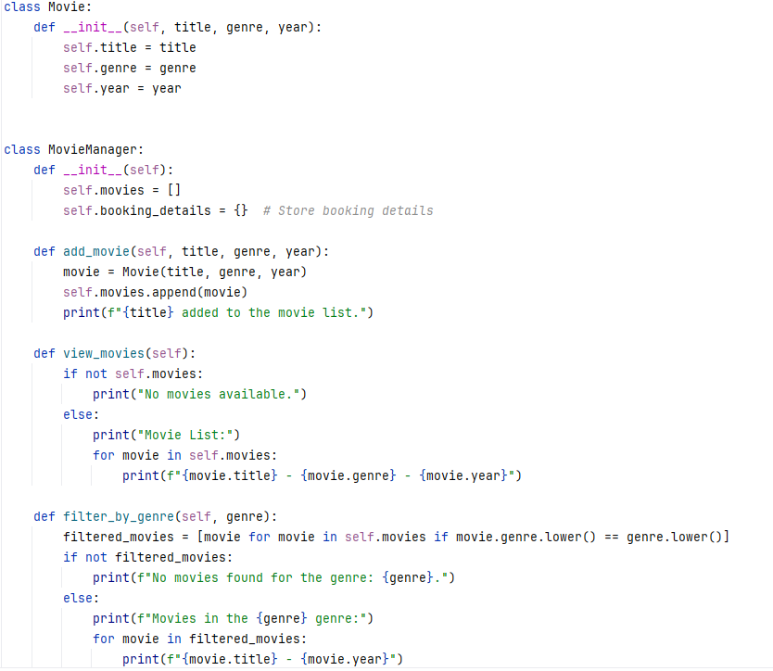
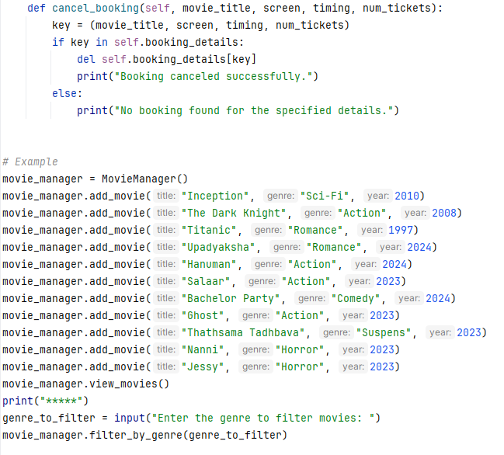
Complete code:

Slide 17
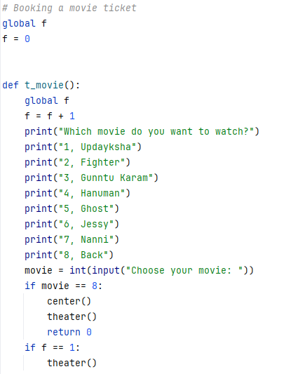
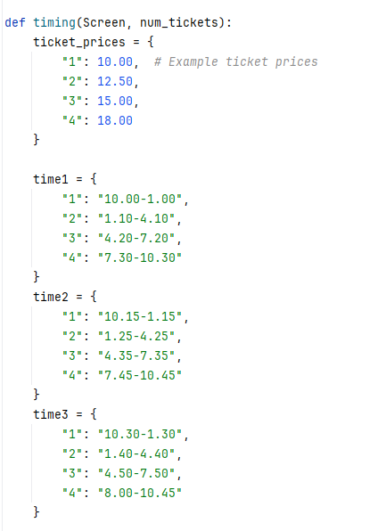
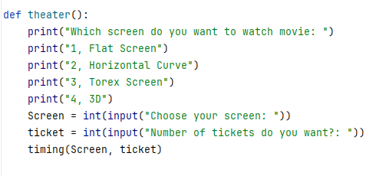

Slide 18
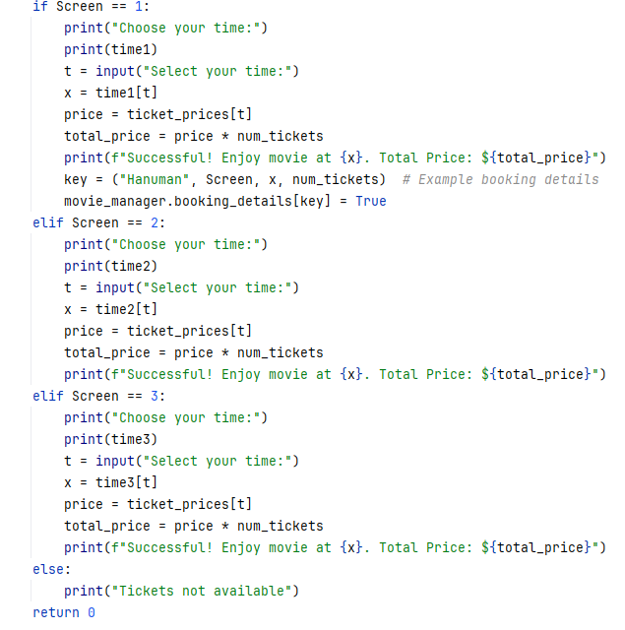
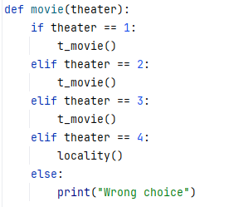
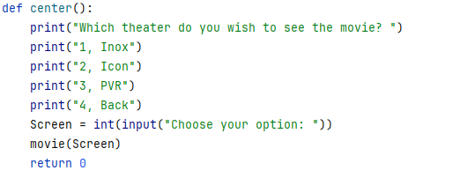

Slide 19
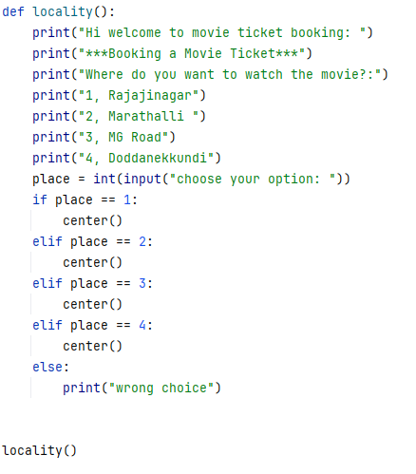
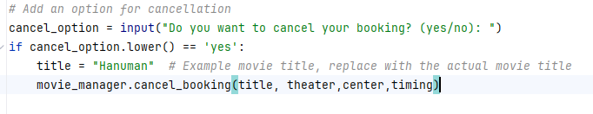

Slide 20
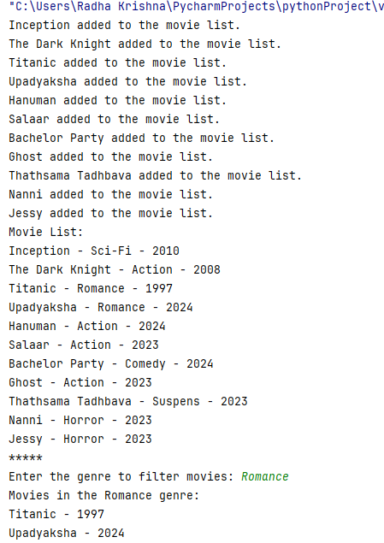
Code Output:

Slide 21
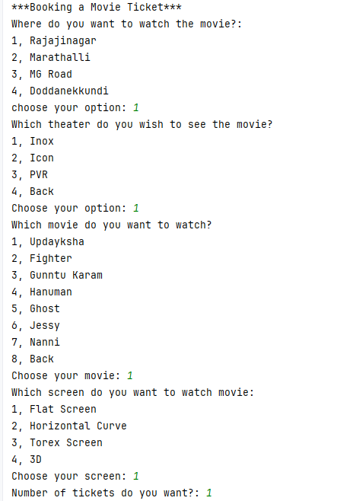
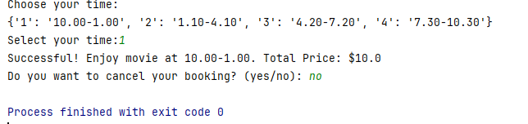

Slide 22
The changes we can make in the project
Search the movies by language
Adding the movies to wish list
To add ratings to the movies
Filter search by directors, producers and ratings
Booking seat numbers.

Slide 23
Future view point on the project:
Features we can add:
Digitalization can be made to improve the quality of movie that can be produced.
Direct access can be provided from producers and directors to the people to access the movie once they are finished.
Assistive technologies: These technologies can make movie management systems more accessible and inclusive for people with disabilities, such as closed captioning, audio descriptions, and hearing loops.
More enhanced lighting can be used for future enhanced quality to screening and lighting.

Slide 24
Summary
A movie management system is used by various departments of the entertainment sector such as directors, producers, movie managers, film studios, film distributors, etc., to keep a track of sales, losses and popularity of the movie in various sectors.
The above project is based on the same concept showcasing how can a movie ticket be booked online and to match your schedule. This is the efficient way to book a movie ticket and enjoy the day with your beloved ones.

Slide 25

TEAM MEMBERS:
ASHMITHA SUMA RAJ
YASHASWINI D
RAJU B
PRASHANT A
DANUSH VARDHAN BOMMU

